Slide 1



GROUP 4
DIGITAL STRATEGIES IN THE BEAUTY INDUSTRY

Slide 2


CONTENTS
01
02
03
Big Data & Digital Strategy
Consumer Behaviour & Experience
Charlotte Tilbury
04
05
Glossier
Fenty Beauty
06
07
08
L’Oreal
Commercial Success
Investment Strategy

Slide 3


What is Big Data?
“Big data refers to massive, complex data sets that traditional data management systems cannot handle. When properly collected, managed and analysed, big data can help organisations discover new insights and make better business decisions.” (Badman & Kosinski, 2024)
BIG DATA & DIGITAL STRATEGY
What is a Digital Strategy?
A plan that integrates technology into a business to create efficient processes, engage effectively with customers, and stay competitive in a digital world. (Olmstead, 2022)
It involves transforming how a business operates and delivers value, understanding customer needs, streamlining operations, and fostering an innovative company culture. (Olmstead, 2022)

Slide 4



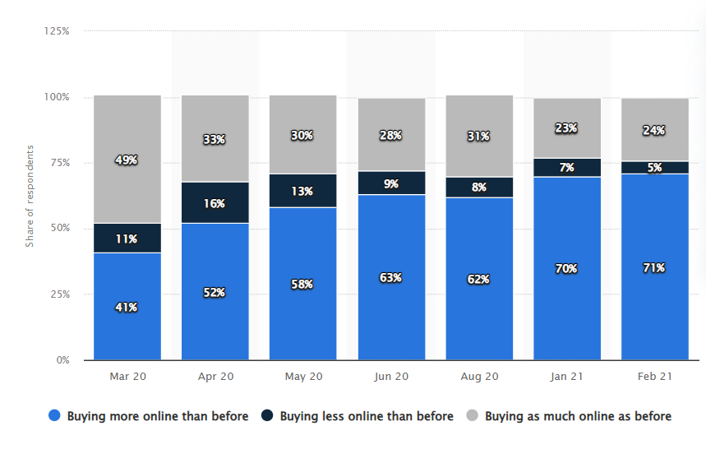

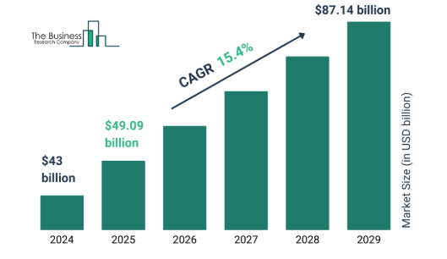
02
CONSUMER BEHAVIOUR & EXPERIENCE
Personalisation and Customisation
Increased Digital Engagement
(2020-2025)
Next-Generation Personalized Beauty Market Size 2025 And Growth Rate
(The Business Research Company, 2025)
Percentage change in online purchases in UK from March 2020 to February 2021 (Statista, 2021)
Shift towards online shopping
Rise of virtual try-ons
Mobile apps and AR features
Growing demand for personalized experiences
Brands that offer customization have captured consumer attention by leveraging data.
(Amed et al., 2021)

Slide 5

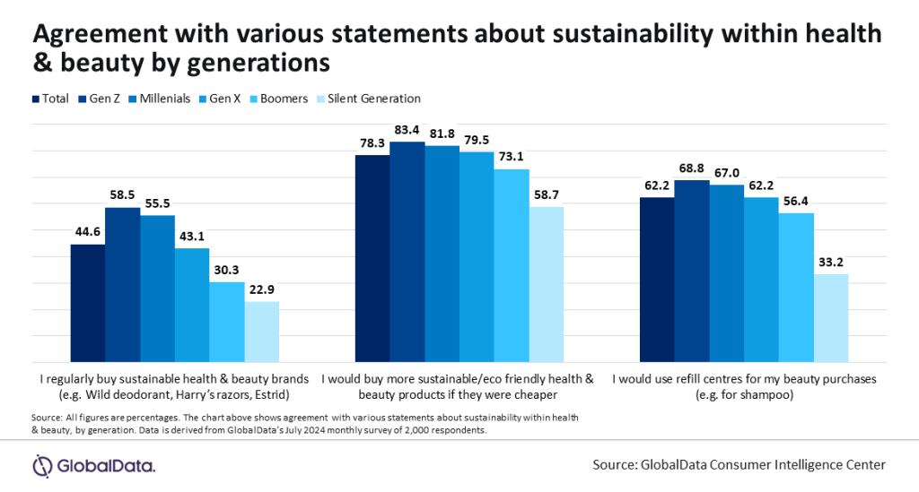
CONSUMER BEHAVIOUR & EXPERIENCE
Sustainability and Ethical Concerns
Growing environmental and ethical considerations when purchasing
Sustainability and cruelty-free claims became significant differentiators for brands.
Agreement about sustainability within health & beauty by generations (GobalData, 2024)
(Amed et al., 2021)

Slide 6

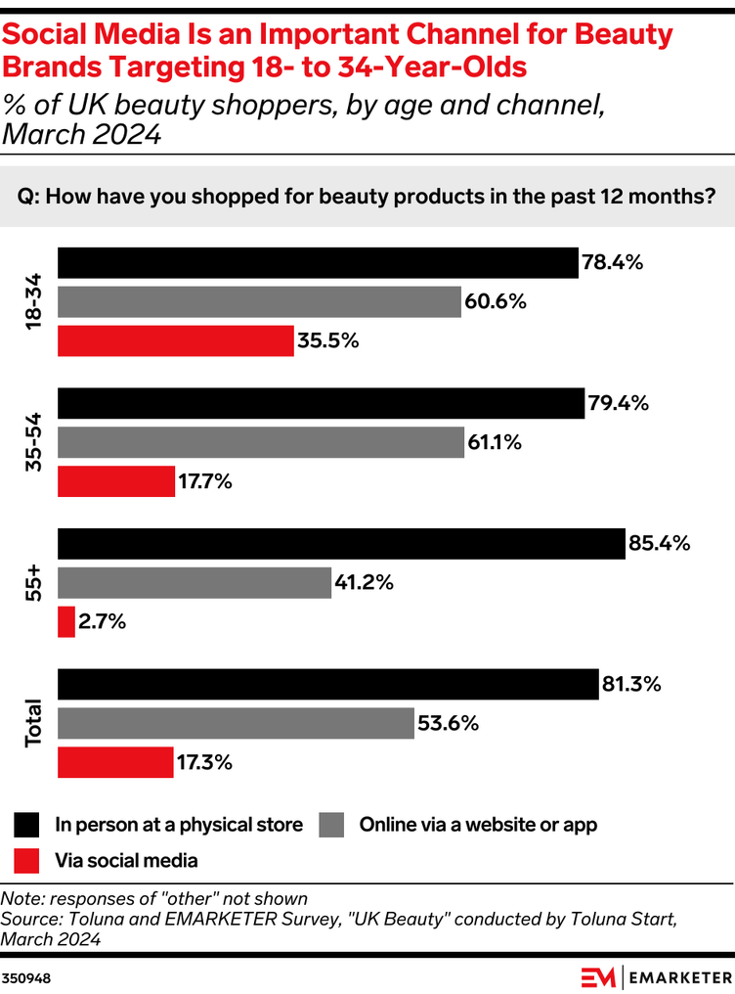
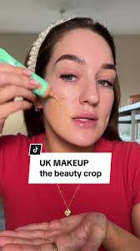
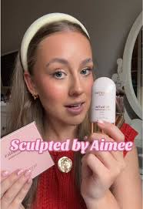
CONSUMER BEHAVIOUR & EXPERIENCE
Social Media Influence
Instagram, TikTok, and YouTube have become central to consumers’ discovery and purchasing behaviors.
Social Media and Beauty Brands (Perkins, 2024)
(Amed et al., 2021)

Slide 7
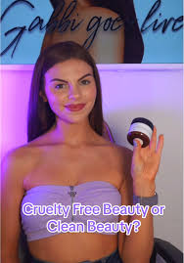

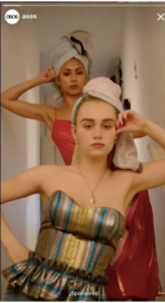


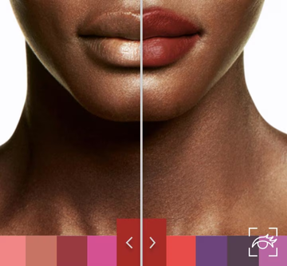

Why target Gen Z?
Growing Purchasing Power: In 2020, Gen Z was already estimated to contribute $143 billion to the global economy.
Skincare Expenditure: In 2021, approximately 37% of UK Gen Z respondents spent between £10 and £20 on a single skincare product (Petruzzi, 2024).
Social Media Savvy: Gen Z is the most digitally native generation.
Brand Loyalty & Advocacy: Gen Z values authenticity and is more likely to support brands that align with their personal values. This generation is less brand loyal than Millennials but is more likely to advocate for brands they trust on social media.
(Finneman et al., 2020)
Health & Wellness
Sustainability and Ethics
Gen Z’s behaviour
Demand for Authenticity
Experience-Oriented Purchases
(BoF, 2024)

Slide 8


03

Slide 9
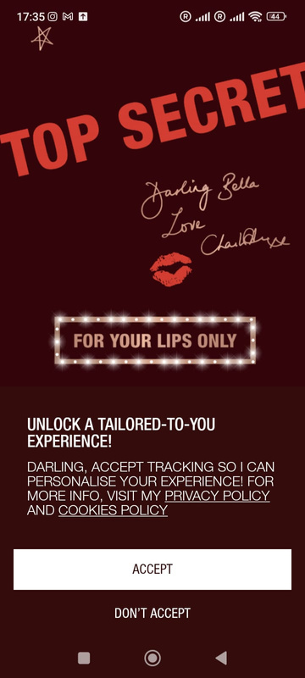
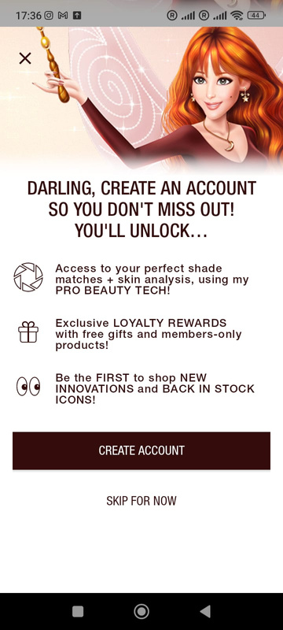
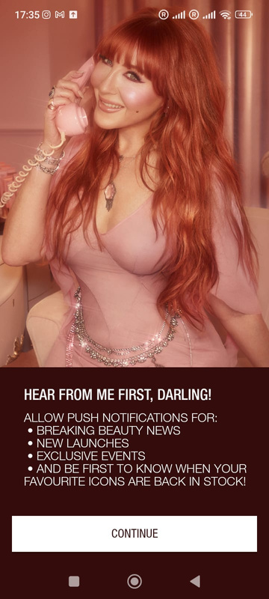
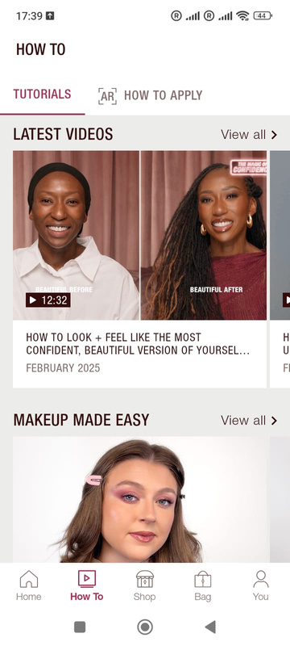
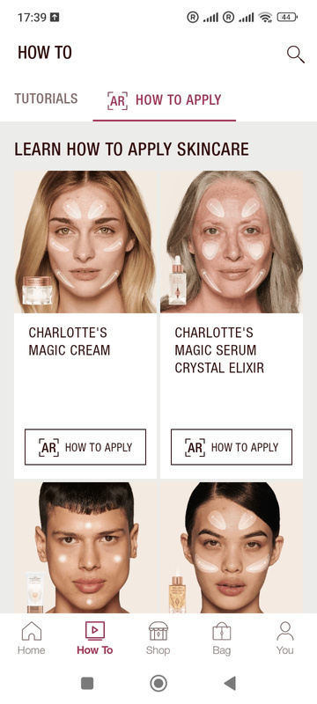
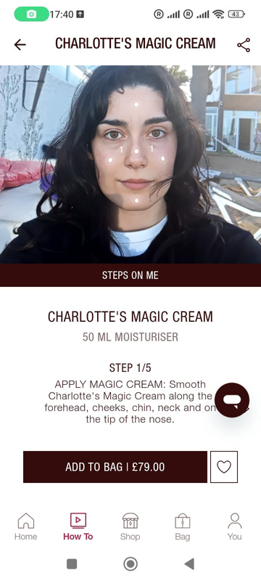
App
Market Strategy: Leveraging the celebrity appeal of its founder, Charlotte Tilbury.
Data Collection: The app enables the collection of first-party data on consumer preferences.
Long-term Goals: The brand will track user engagement and retention, aiming to build a loyal customer base through exclusive offers and features.
(Chitrakorn, 2023)
Features:

Slide 10
App
Strengths
Weaknesses
Expert Content
Exclusive Access
Celebrity Appeal
Data Collection
App Adoption: Convincing users to download and regularly use the app
Tech Dependency: Users with less advanced smartphones or slower internet connections may not experience the full benefits of AI tools or high-quality videos.
Opportunities
Threats
Growing Beauty Tech Market
Global Reach: The app can expand to new markets, particularly in regions where Charlotte Tilbury’s brand is growing but physical stores are limited.
High Competition
User Retention: Users may lose interest over time
Privacy Concerns
Match the hype with expectations

Slide 11
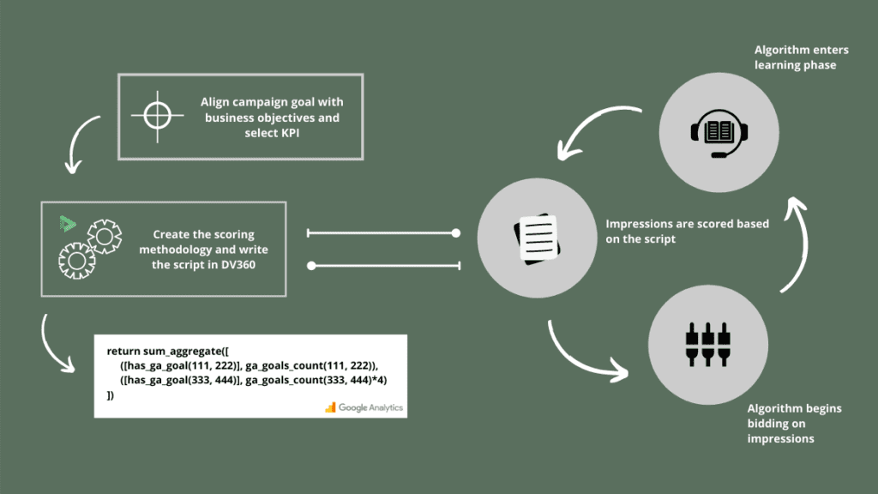

Custom Bidding Strategies
Custom Bidding: They improved ad performance and efficiency by tailoring their bidding methods to specific campaign goals.
Turning to Display & Video 360’s automated bidding solutions to optimize the performance of their campaigns.
Data-Driven Approach: The brand utilized data insights to optimize its bidding strategies, focusing on high-value customers.
Increased Conversions: The new strategies led to a significant increase in conversions, demonstrating the effectiveness of personalized marketing efforts.
(Leung, n.d.)
Custom Bidding (Data Studio, 2021)

Slide 12
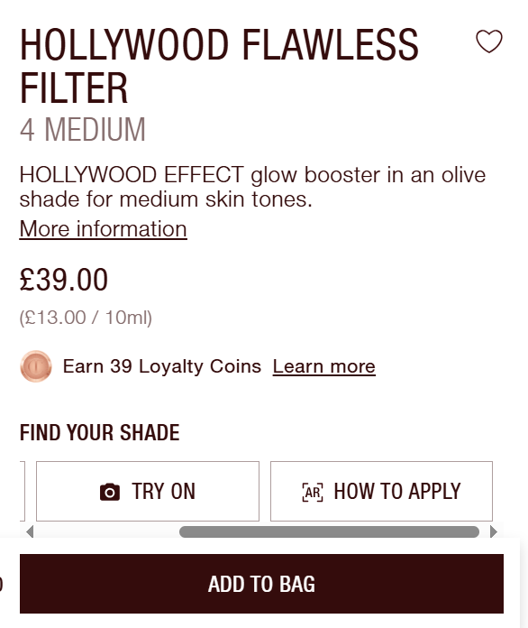
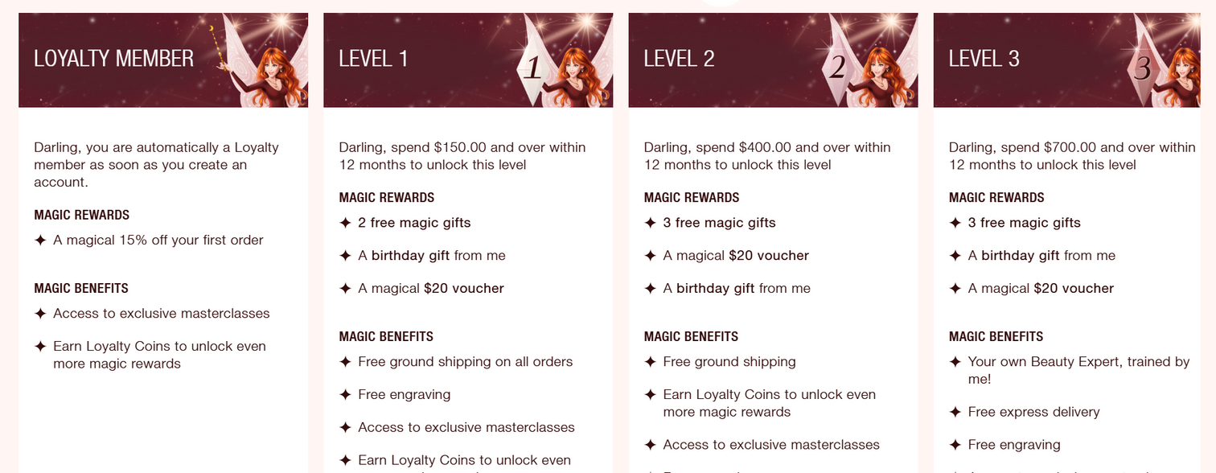

Loyalty Program
Exclusive Rewards: Members receive benefits like early access to product launches, restock notifications, personalized gifts, and discounts.
Personalized Experience: The tiered system provides tailored services, such as free consultations with beauty experts, enhancing customer satisfaction and loyalty.
(Desiree, 2024)
Charlotte Tilbury Loyalty Program (Desiree, 2024)
Gamification

Slide 13

04

Slide 14
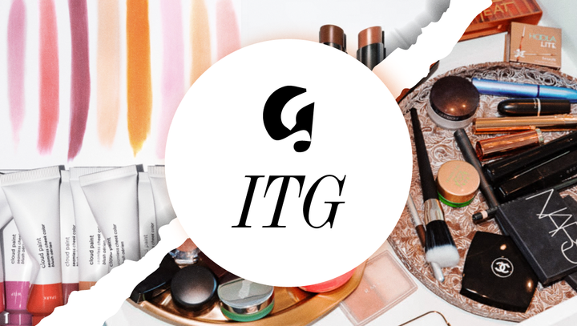
Community-Driven Marketing
Social Media & UGC
Glossier encourages customers to showcase their looks on Instagram, TikTok, and their website.
On Instagram, Glossier interacts with its audience through polls regarding product design or by answering users’ Q&A’s.
This traces back to the 2010 launch of the beauty blog Into the Gloss:
© Glossier
The blog’s writers understood their audience’s beauty routines by directly asking what products they used and why. This open dialogue established a strong social media connection with fans and, over time, provided valuable insights into their real desires for beauty and skincare products. (Pallud, 2018)

Slide 15
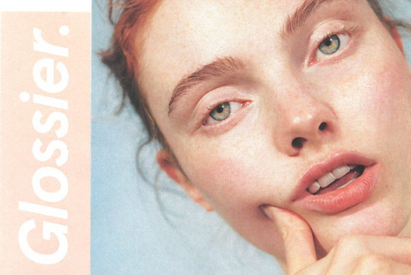
Community-Driven Marketing
2. “Skin first. Makeup second.”
The concept is simple: providing affordable, simple but performing cosmetics.
Their slogan positions their brand towards a younger Gen Z crowd who value simplicty in their beauty products (Extole, 2024).
Instead of using airbrushed models who looked fake and unattainable, the brand used women whose faces mirrored the real-world diversity of women who buy makeup (Extole, 2024).
Inclusivity and diversity are among the important influences on the Gen-Zer’s purchasing decisions (McKinsey, 2024)
© Glossier

Slide 16
Community-Driven Marketing
Strengths
Weaknesses
Strong Social Media Presence & UGC
Direct Consumer Insights & Model
Authenticity & Inclusivity
Brand Loyalty
Over-Reliance on Digital
Changing consumer preferences
Lack of personalisation
Opportunities
Threats
International market expansion
Influencer & brand collaborations - 49% consumers rely on influencer collabs
AI & AR Personalisation
Sustainability
Increasing competition
Changing consumer trends - shift away from “clean girl” aesthetic
Potential Backlash on Authenticity/Diversity Claims - 2022 “white-washing” allegations

Slide 17

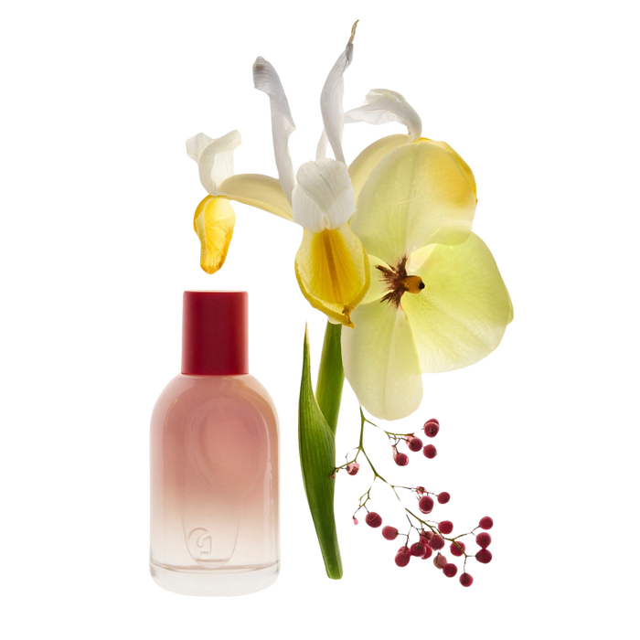
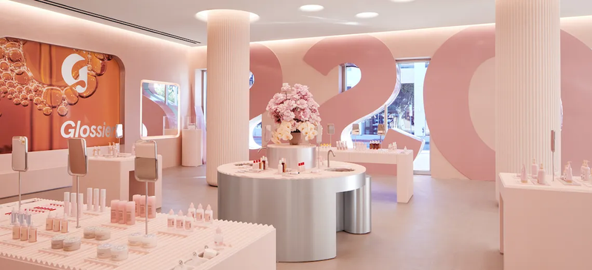
Blending Online & In-Store
In-store: customers place orders through a floor assistant’s iPad, and pick up their purchases when their name is called.
In 2023, Glossier You fragrance pop-up in London took sensory engagement to the next level.
Only hosting 6 people at once, this personalised journey makes sure the products are fully explored.
1st room: ASMR-inspired film showcasing the fragrance’s formats
2nd room: offered an interactive experience with red-gloved hands emerging from curtains (each with a unique personality) engaging visitors before handing them a red rose (Coates, 2023)
By bridging the gap between digital and physical spaces and curating personalised, in-store moments, brands can captivate and retain Gen-Z consumers in an ever-evolving beauty landscape. (McKinsey, 2023)
(Glossy, 2021)

Slide 18
Blending Online & In-Store
Strengths
Weaknesses
Reaching ‘bricks’ consumer
Omnichannel retail experience
Personalised service
Gen Z - half/half
Dependence on staff - slow down process/rush hour
High Costs of Experiential Retail
Dependance on technology
Opportunities
Threats
Self-service checkout and go to pick up
Loyalty & Membership programs
Scalability - hard to maintain the same level across multiple locations
Technological Issues & Data Privacy Concerns

Slide 19
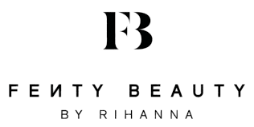
05

Slide 20
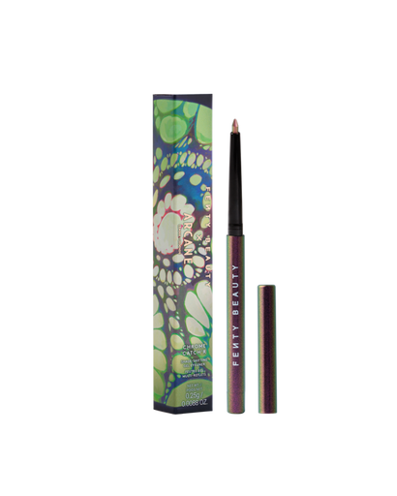
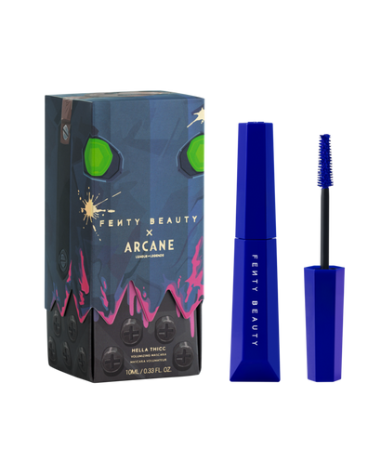
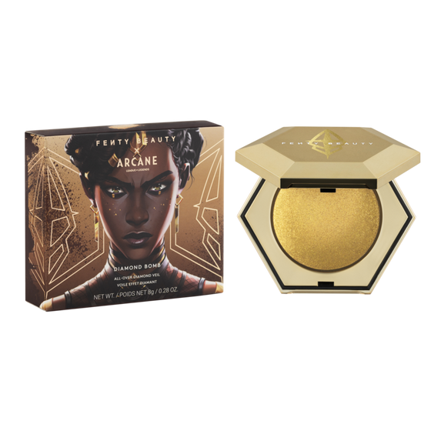
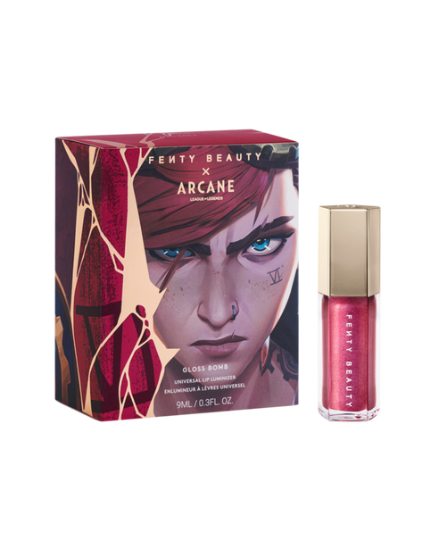
Inclusivity & Brand Collab
In 2017, Fenty launched a groundbreaking foundation line with 40 shades, sparking the "Fenty Effect"—a movement pushing brands toward greater diversity. (Arash F, 2023)
Fenty merges inclusivity with digital culture by tapping into diverse communities, including gaming.
October 2024, collaborated with Netflix’s Arcane, series based on League of Legends, launching its first gamer-inspired makeup collection. (Glossy, 2024)
The "Fenty Beauty x Arcane" collection featured products inspired by the show’s female leads: Jinx, Vi, Mel, and Caitlyn. (Business Insider, 2024)
Chrome Catch’r Shade-Shifting Gel Eyeliner
shade "Anoma’Lit”
Hella Thicc Volumizing Mascara named "Ka-Bluey”
Diamond Bomb All-Over Diamond Veil in shade "Golden Rul’r”
Gloss Bomb Universal Lip Luminizer
in shade “Vi”

Slide 21
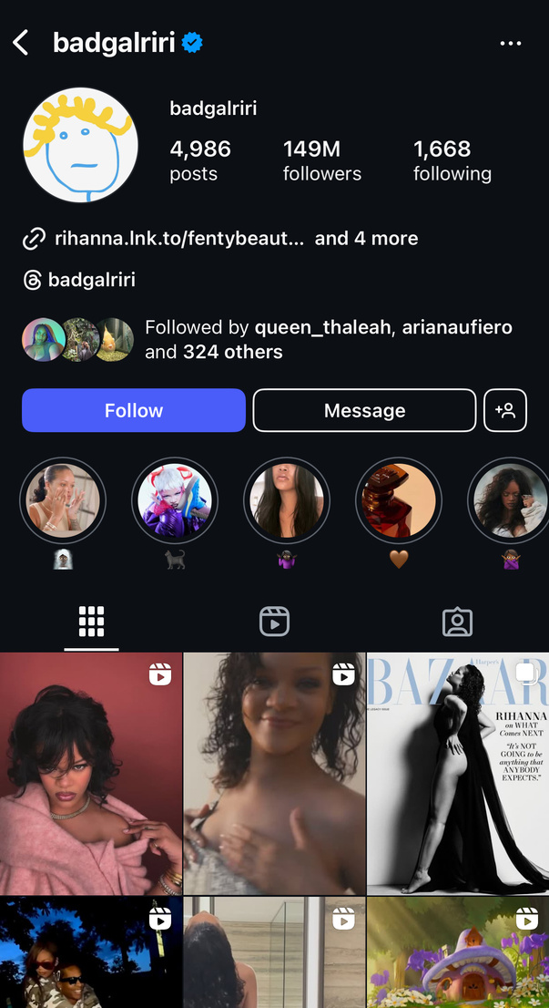
Celebrity Influence
Rihanna’s celebrity status boosts Fenty Beauty’s reach.
150M Instagram followers add credibility and aspirational value.
Fans trust her endorsements, driving brand loyalty.
She actively promotes Fenty Beauty on social media.
Shares tutorials, product launches, and skincare routines.
Creates authenticity and trust with her audience.
(House of Marketers, 2024)

Slide 22

Customer Experience Enhancements
The Role of Data in Digital Strategy
Fenty Beauty uses consumer data analytics to personalize marketing efforts, predict trends, and optimize product offerings. (McKinsey, 2022).
Fenty Beauty’s AR-powered tools, such as the Sephora Virtual Artist, allow users to test makeup products digitally. (TechCrunch, 2023).
Consumer Behavior and Engagement Strategies
Fenty Beauty has capitalised on social commerce by integrating shopping features within Instagram, TikTok, and YouTube. (Statista, 2024).

Slide 23
Influencer Marketing
Strengths
Weaknesses
Diverse Influencer Partnerships
Strategic Use of Micro-Influencers
Celebrity Endorsement by Rihanna
Reliance on Rihanna’s Personal Brand
Potential for Influencer Controversies
Costly Marketing Strategy
Opportunities
Threats
Expansion into Emerging Markets
Subscription Boxes and Influencer-Led Curated Collections
Sustainability-Focused Influencer Marketing
Algorithm Changes on Social Media
Economic Downturn Affecting Luxury Purchases
Increasing Competition from Other Inclusive Brands

Slide 24

06

Slide 25
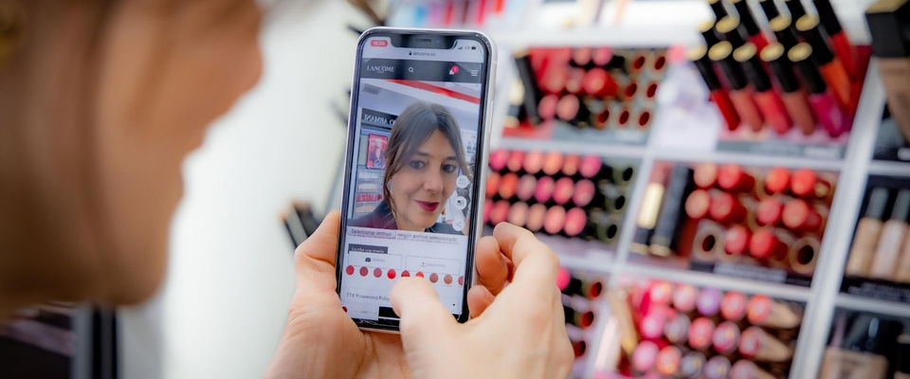
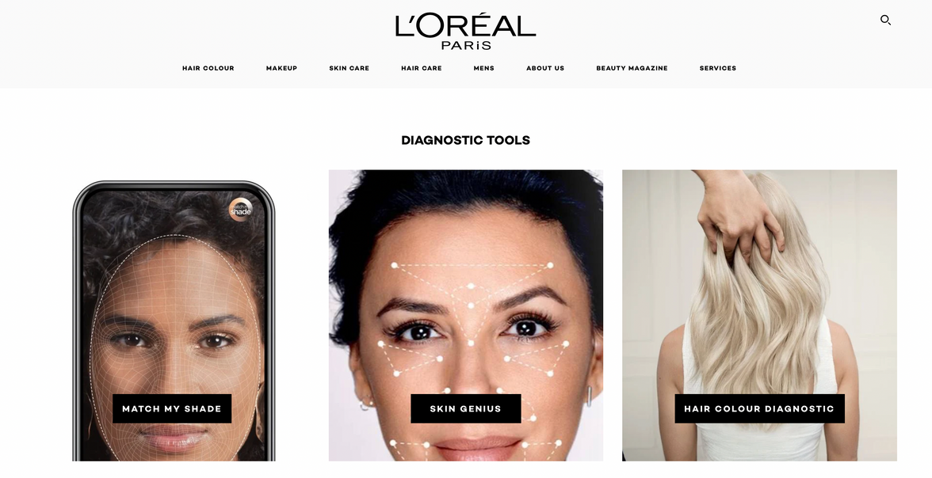
Digital Innovation & AI-Powered Personalization
ModiFace AR & AI-powered Try-Ons -
L’Oréal's ModiFace technology allows customers to virtually try on makeup through Instagram, Snapchat, and brand websites. It enhances product discovery and reduces return rates by 20% (Forbes, 2023).
Google Cloud for Precision Advertising
L’Oréal leverages Google Cloud AI to optimize digital ad campaigns, increasing conversion rates by 30% through targeted, data-driven marketing (Marketing Dive, 2023).
AI Skin Analysis – Skin Genius & Perso
The Skin Genius tool assesses skin conditions from selfies and recommends personalized skincare products, while Perso creates custom skincare & lipstick shades tailored to user preferences (TechCrunch, 2024).

Slide 26
SWOT ANALYSIS: L’OREAL’S DIGITAL STRATEGY
Strengths
Weaknesses
Advanced AI technology (ModiFace, Skin Genius)
Industry leadership in digital beauty
Strong partnerships (Google Cloud, social media)
High investment costs for AI and tech integration
Dependence on data accuracy for AI recommendations
Potential privacy concerns with AI-driven personalization
Opportunities
Threats
Rising demand for personalized beauty experiences
Expansion in emerging digital markets
Growth in e-commerce and social commerce
Intense competition from tech-driven beauty startups
Evolving data privacy regulations
Dependence on policies of social media platforms

Slide 27
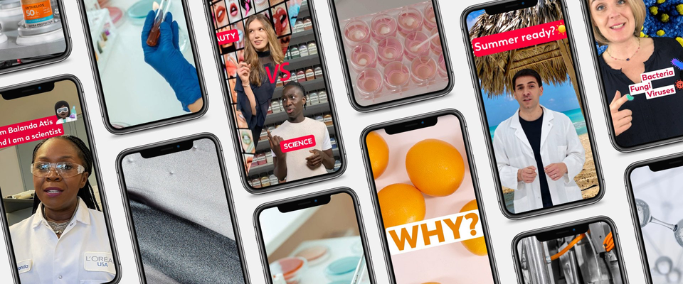
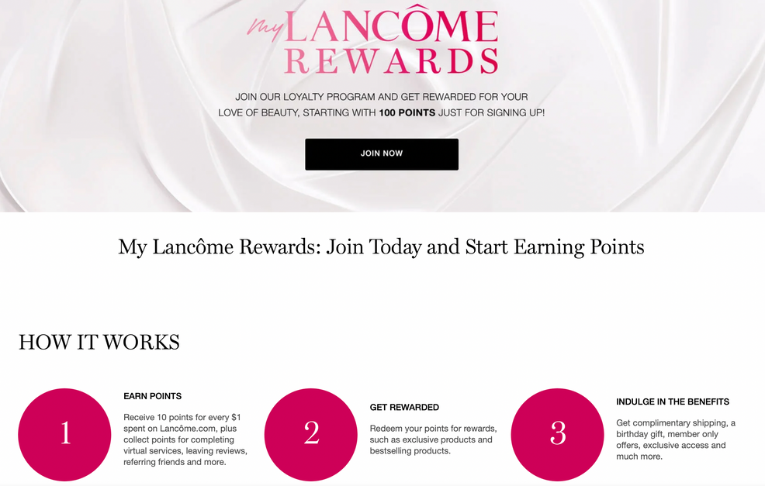
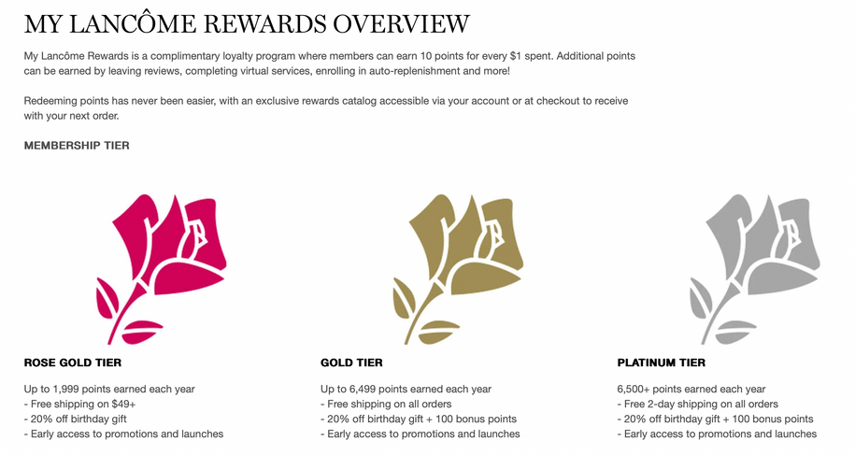
Social Commerce & Loyalty Programs
TikTok's Role in L’Oréal’s Growth
L’Oréal utilizes #LOrealParis trends, branded challenges, and influencer collaborations to drive engagement.
AI-Driven Loyalty Programs
Programs like Lancôme Elite Rewards & NYX VIP offer personalized rewards, early access to launches, and VIP consultations, increasing retention by 20% (Forbes, 2024).

Slide 28
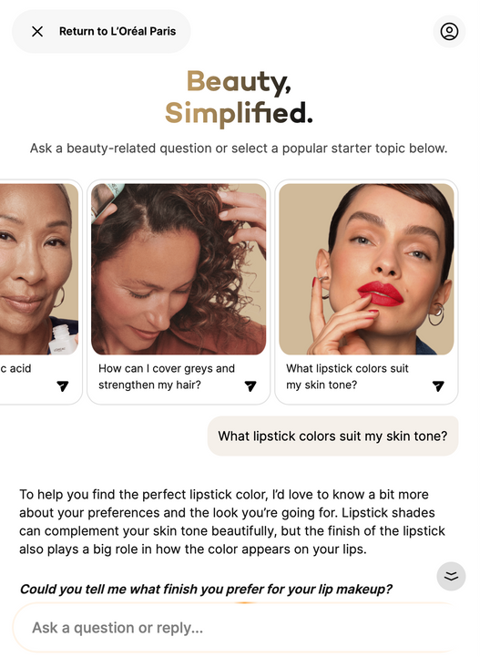
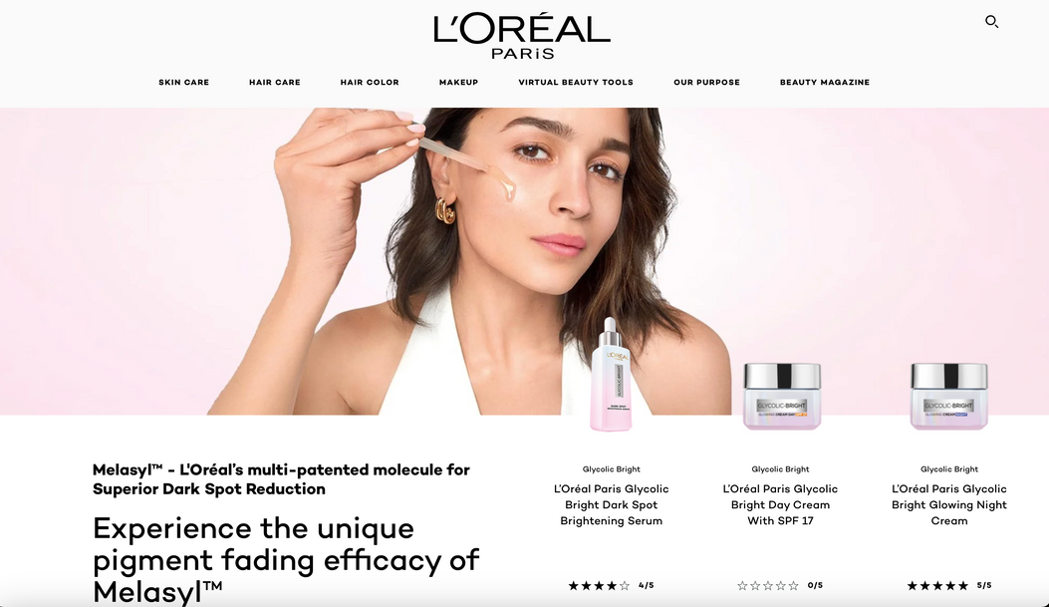
AI & Smart Beauty Tech
AI Assistants on L’Oréal’s Website
L’Oréal integrates AI assistants on their website for beauty consultations, allowing users to receive real-time product recommendations, skincare advice, and makeup tutorials.
Omnichannel Shopping Enhancements
Customers can seamlessly switch between in-store experiences and online purchases, improving the overall shopping experience. ​

Slide 29
07
COMMERCIAL SUCCESS

Slide 30

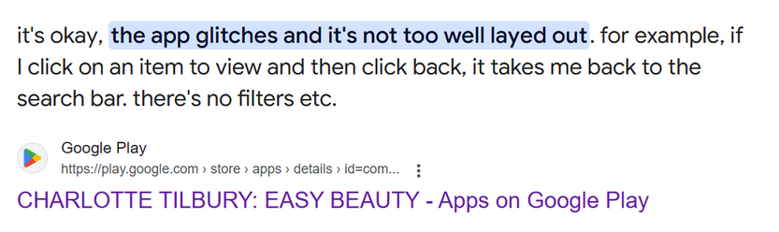
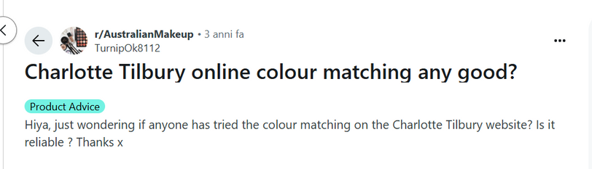

Custom Bidding Strategies
Charlotte Tilbury Beauty achieved a 29% reduction in cost per acquisition (CPA) through custom bidding strategies using Google Marketing Platform (Leung, n.d.).
In North America, the affiliate program achieved 35% revenue uplift (Osum, 2024).
Loyalty Program
App
App Review (Google Play, n.d.)
“I kept getting the same recommendation”
“the logo kept appearing on the user’s face”
“not as accurate as Temptalia foundation matrix”
Social Media
The engagement rate on their social media is 0.12% (HypeAuditor, 2025), which is considered average. Fenty Beauty has an engagement rate of 0.32% (Statista, 2025)

Slide 31
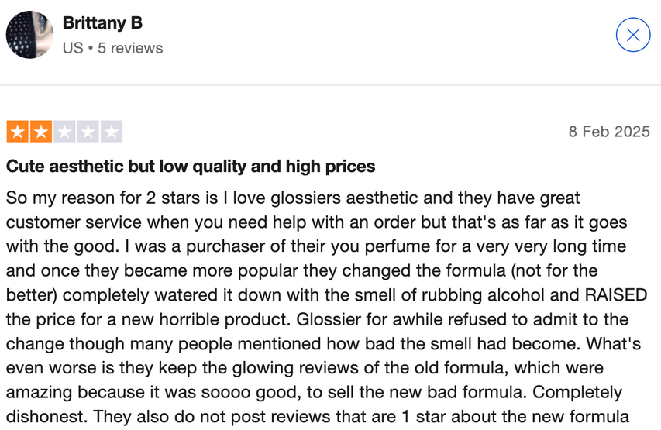
$133.8M ecommerce net sales (Statista, 2024)
56% of Glossier users display loyalty towards the brand (Statista, 2024)
Limited Product Range - only 28 SKU’s VS L’Oreal over 500 SKU’s
Changed the formula of their ‘You’ perfume but kept the glowing reviews of their old formula on their website (Trustpilot, 2025).
Do not post 1 star reviews.

Slide 32
Brand & Influencer Collaboration
Branded Hashtags: #FentyFace and #FentyBeauty alone generated over 4.5 million posts. ​
The Fenty X Arcane campaign's content library garnered views ranging from 365,000 for behind-the-scenes footage to 16 million for Rihanna's product introduction. (Shorty Awards 2024)
Their Instagram garners a total engagement of 39.46 million interactions. (Statistica, 2024)
In November 2024, Fenty Beauty ranked 8th among top U.S. beauty brands based on the Brand Vitality Index (VIT)
Fenty Beauty's emphasis on inclusivity and diversity did not align with Chinese beauty standards that favor lighter skin tones.
In 2020, Fenty Beauty faced a lawsuit alleging that its website was not accessible to visually impaired users, indicating challenges in ensuring digital inclusivity.

Slide 33
Digital Transformation
By implementing a Customer Data Platform (CDP), the company achieved a 22.22% conversion rate in media campaigns, surpassing average rates.
Click-through rates increased by 26.25%, reflecting improved customer engagement. (Tealium, 2024)
AI and AR enabled 100 million virtual try on sessions in 2023.
E-commerce Growth: In 2021, L'Oréal's e-commerce sales grew by 25.7%, accounting for 28.9% of total sales. ​(Tealium, 2024)
L'Oréal's data platform houses 10 petabytes of data, powering various AI models, including the latest large language models (LLMs).

Slide 34
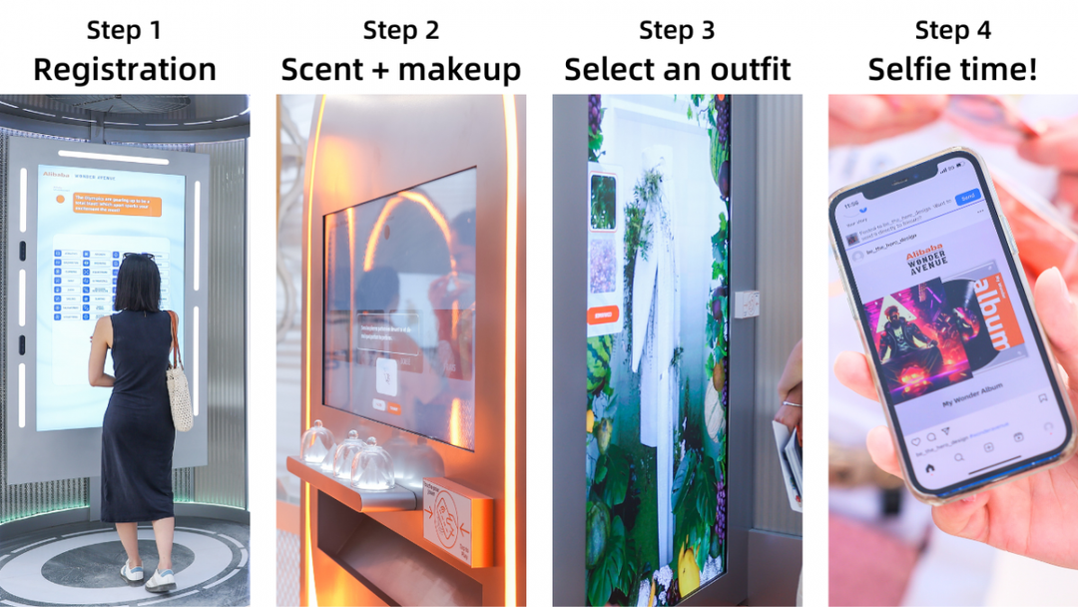
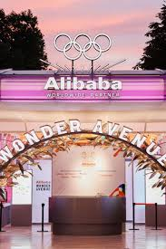
08
INVESTMENT
DIGITAL WARDROBE INTEGRATION
Paris 2024 Olympics.
1.Alibaba Wonder Avenue
Engage in runway shows with their digital twins, merging virtual try-ons with outfit matching
(Vogue Business, 2024)

Slide 35
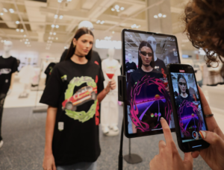
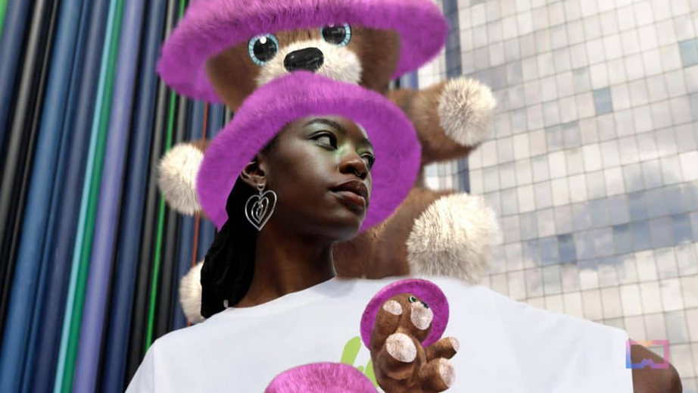
08
INVESTMENT
DIGITAL WARDROBE INTEGRATION
Inspired over 64,000 pieces of UGC’S, more than ten million online impressions, and achieved a complete sell-out. (CXMToday, 2024)
2.FFFACE.ME and Bershka Partnership
April 2023
Add digital elements to specific physical garments using an Instagram filter, blending physical attire with virtual enhancements.
(Retail Technology Innovation Hub, 2024)

Slide 36
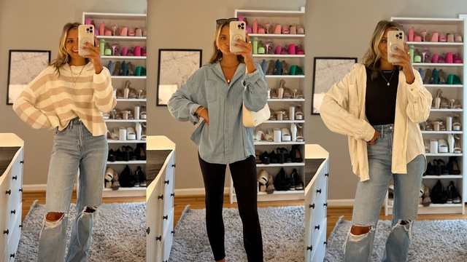


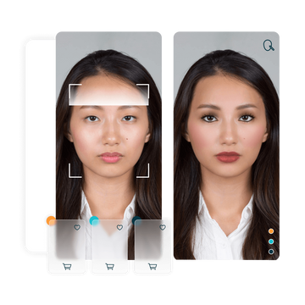
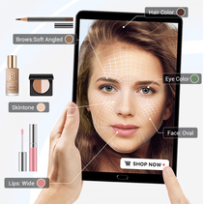
08
INVESTMENT
DIGITAL WARDROBE INTEGRATION
Potential Strategy
Step 1: Outfit Upload
Step 2: AI-Based Suggestions
Step 3: AR Virtual Try-On
Step 4: Purchase and Style Recommendations
Step 5: Continuous Learning
Increased Engagement
and Sales
Seamless User
Experience
Sustainability
Brand Loyalty

Slide 37
Reference List
Amed, I. et al. (2021) The state of fashion 2021, McKinsey & Company. Available at: https://www.mckinsey.com/~/media/mckinsey/industries/retail/our%20insights/state%20of%20fashion/2021/the-state-of-fashion-2021-vf.pdf (Accessed: 09 March 2025).
Bershka FFFACE.ME collection connects physical apparel with interactive tiktok experiences (2024) Retail Technology Innovation Hub. Available at: https://retailtechinnovationhub.com/home/2024/11/6/bershka-and-fffaceme-team-up-on-collection-that-connects-physical-apparel-with-interactive-
experiences-on-tiktok (Accessed: 10 March 2025).
Business Insider (2024) Rihanna's Fenty Beauty is making a bet on the gaming business in the shape of a $250 makeup kit. Available at: https://www.businessinsider.com/rihanna-fenty-beauty-netflix-arcane-vault-makeup-collaboration-2024-10 (Accessed: 5 March 2025).
Charlotte Tilburys Target Market Exploration (2024) Osum. Available at: https://blog.osum.com/charlotte-tilbury-target-market/? (Accessed: 11 March 2025).
Checa, A. et al. (2025) How beauty players can scale Gen AI in 2025, McKinsey & Company. Available at: https://www.mckinsey.com/industries/consumer-packaged-goods/our-insights/how-beauty-players-can-scale-gen-ai-in-2025? (Accessed: 09 March 2025).
Chitrakorn, K. (2023) Can Charlotte Tilbury Beauty convince customers to download an app?, Vogue Business. Available at: https://www.voguebusiness.com/beauty/can-charlotte-tilbury-beauty-convince-customers-to-download-an-app (Accessed: 09 March 2025).
Desiree, T. (2024) Charlotte Tilbury perfected this strategy for customer retention, RSS. Available at: https://www.desireedesign.co.uk/brand-insider/charlotte-tilbury-loyalty-program-success (Accessed: 09 March 2025).
Finneman, B., Spagnuolo, E. and Rahilly, L. (2020) Meet Generation Z: Shaping the future of Shopping, McKinsey & Company. Available at: https://www.mckinsey.com/industries/consumer-packaged-goods/our-insights/meet-generation-z-shaping-the-future-of-shopping (Accessed: 09 March 2025).
Francis, T. and Hoefel, F. (2018) ‘true gen’: Generation Z and its implications for companies, McKinsey & Company. Available at: https://www.mckinsey.com/industries/consumer-packaged-goods/our-insights/true-gen-generation-z-and-its-implications-for-companies? (Accessed: 09 March 2025).

Slide 38
Glossy (2024) Exclusive: Fenty partners with Netflix’s Arcane for a gamer-inspired collection. Available at: https://www.glossy.co/pop/exclusive-fenty-partners-with-netflixs-arcane-for-a-gamer-inspired-collection (Accessed: 5 March 2025).
House of Marketers (2024) Fenty Beauty’s social media strategy: A case study. Available at: https://www.houseofmarketers.com/fenty-beauty-social-media-strategy-case-study (Accessed: 5 March 2025).
Hudson, S., Kim, A. and Moulton, J. (2018) What beauty players can teach the consumer sector about Digital Disruption, McKinsey & Company. Available at: https://www.mckinsey.com/industries/consumer-packaged-goods/our-insights/what-beauty-players-can-teach-the-consumer-sector-about-digital-disruption? (Accessed: 09 March 2025).
Instagram: Leading Beauty Brands by engagement 2023 | statista (2025) Statista. Available at: https://www.statista.com/statistics/670550/leading-beauty-brands-instagram-engagement/ (Accessed: 11 March 2025).
Leung, A. (no date) Charlotte tilbury beauty reduces CPA by 29% with custom bidding, Google. Available at: https://marketingplatform.google.com/about/resources/charlotte-tilbury-beauty-reduces-cpa-by-29-percent-with-custom-bidding/ (Accessed: 09 March 2025).
Petruzzi, D. (2024) United Kingdom: Average spend of gen Z on a skincare product 2021 | statista, Statista. Available at: https://www.statista.com/statistics/1288976/average-spend-of-gen-z-on-skincare-in-the-uk/ (Accessed: 09 March 2025).
Scott, N. (2024) Tiktok shop, specialist retail and Amazon’s ascent: Navigating the new beauty landscape, Vogue Business. Available at: https://www.voguebusiness.com/story/advanced/tiktok-shop-specialist-retail-and-amazons-ascent-navigating-the-new-beauty-landscape? (Accessed: 09 March 2025).
Statista (2024) Leading celebrity beauty brands worldwide by revenue. Available at: https://www.statista.com/statistics/1372858/leading-celebrity-beauty-brands-worldwide-by-revenue (Accessed: 5 March 2025).
Tsoi, A. and Liu, M. (2023) How Charlotte Tilbury Beauty responds to Customer Data Requests | Google Cloud Blog, Google. Available at: https://cloud.google.com/blog/topics/customers/how-charlotte-tilbury-beauty-responds-to-customer-data-requests (Accessed: 09 March 202en35).

Slide 39
VentureBeat (2024) Riot Games and Rihanna’s Fenty Beauty team up on Arcane beauty products. Available at: https://venturebeat.com/games/riot-games-and-rihannas-fenty-beauty-team-up-on-arcane-beauty-products (Accessed: 5 March 2025).
Vogue Business in partnership with Alibaba (2024) ‘Wonder Avenue’: How futuristic shopping won a spot at the Olympics, Vogue Business. Available at: https://www.voguebusiness.com/story/technology/wonder-avenue-how-futuristic-shopping-won-a-spot-at-the-olympics? (Accessed: 10 March 2025).
100% AI-powered Influencer Marketing Platform: Hypeauditor (2025) HypeAuditor. Available at: https://hypeauditor.com/ (Accessed: 11 March 2025).
Forbes (2023) 'Navigating the digital future: How cutting-edge technologies are revolutionizing marketing and content creation', Forbes Agency Council. Available at: https://www.forbes.com/councils/forbesagencycouncil/2023/12/19/navigating-the-digital-future-how-cutting-edge-technologies-are-revolutionizing-marketing-and-content-creation/ (Accessed: 12 March 2025).
Forbes (2024) 'VivaTech: Why L'Oréal is partnering with Meta and leveraging Gen AI', Forbes. Available at: https://www.forbes.com/sites/stephaniehirschmiller/2024/05/25/vivatech-why-loral-is-partnering-with-meta-and-leveraging-gen-ai/ (Accessed: 12 March 2025).
L'Oréal (2024) 'L'Oréal at CES 2024', L'Oréal Newsroom. Available at: https://www.loreal.com/en/news/research-innovation/ces/ (Accessed: 12 March 2025).
L'Oréal (2024) 'L'Oréal accelerates beauty tech leadership with advanced bioprinted skin technology and Gen AI', L'Oréal Finance. Available at: https://www.loreal-finance.com/eng/news-event/loreal-accelerates-beauty-tech-leadership-advanced-bioprinted-skin-technology-and-gen-ai (Accessed: 12 March 2025).
L'Oréal (2025) 'Skin Genius Personalized Skin Analysis Tool', L'Oréal Paris USA. Available at: https://www.lorealparisusa.com/skin-genius-landing-page (Accessed: 12 March 2025).
Markovate (2024) 'AI Virtual Try-On: The future of online shopping', Markovate. Available at: https://markovate.com/ai-virtual-try-on/ (Accessed: 12 March 2025).
PYMNTS (2024) 'L'Oréal sees 150% increase in virtual try-ons as consumers seek AR immersion', PYMNTS.com. Available at: https://www.pymnts.com/news/retail/2024/loreal-sees-150percent-increase-in-virtual-try-ons-as-consumers-seek-ar-immersion/ (Accessed: 12 March 2025).
Tealium (2024) 'L'Oréal leads the global beauty industry by decoding digital transformation', Tealium Case Study. Available at: https://tealium.com/resource/case-study/loreal-leads-the-global-beauty-industry-by-decoding-digital-transformation/ (Accessed: 12 March 2025).

Slide 40
Image Reference List
Business Insider (2024) Rihanna's Fenty Beauty is making a bet on the gaming business in the shape of a $250 makeup kit. Available at: https://www.businessinsider.com/rihanna-fenty-beauty-netflix-arcane-vault-makeup-collaboration-2024-10 (Accessed: 5 March 2025).
CHARLOTTE TILBURY: EASY BEAUTY (n.d.), Google Play [image]. Available at: https://play.google.com/store/apps/details?id=com.charlottetilbury.magic. (Accessed: 09 March 2025).
Desiree, T. (2024) Charlotte Tilbury perfected this strategy for customer retention, RSS [image]. Available at: https://www.desireedesign.co.uk/brand-insider/charlotte-tilbury-loyalty-program-success (Accessed: 09 March 2025).
GlobalData (2024) Price continues to be a barrier to entry for many consumers considering sustainable health & beauty, particularly younger consumers., Retail Insight Network [image]. Available at: https://www.retail-insight-network.com/analyst-comment/uk-consumers-premium-sustainable-health-beauty/. (Accessed: 09 March 2025).
Hertsenberg, T. (2023) The top health and beauty trends driving purchases, The Baazar Voice [image]. Available at: https://www.bazaarvoice.com/blog/the-top-health-and-beauty-trends-driving-purchases/. (Accessed: 09 March 2025).
Next-Generation Personalized Beauty Global Market Report 2025 (2025) The Business Research Company [image]. Available at: https://www.thebusinessresearchcompany.com/report/next-generation-personalized-beauty-global-market-report. (Accessed: 09 March 2025).
Percentage change in online purchases due to the coronavirus (COVID-19) pandemic in the United Kingdom from March 2020 to February 2021 (2021) Statista [image]. Available at: https://www.statista.com/statistics/1230225/changes-in-online-buying-among-uk-consumers-since-covid-19/. (Accessed: 09 March 2025).
Perkins, C. (2024) UK Beauty 2024, Emarketer [image]. Available at: https://www.emarketer.com/content/uk-beauty-2024. (Accessed: 09 March 2025).
The Ultimate Guide to Custom Bidding in Display and Video 360 (DV360) (2021) Data Studio [image]. Available at: https://www.datastudio.ca/custom-bidding/the-ultimate-guide-to-custom-bidding-in-display-and-video-360-dv360/. (Accessed: 09 March 2025).

Slide 42
THANK YOU VERY MUCH!

